Slide 1
PREVIOUS CLASSES
1- Error analysis
2- Precession, Resolution etc.
3- Examples of different applications of Vacuum Techniques
4- Units of Pressure and its conversions
5- Basics of Gas Properties
6- Gas laws
7- Velocity of gasses etc.
8- Molecular incident rate, Mean free path
9- Viscosity
Diffusion of Gas

Slide 2
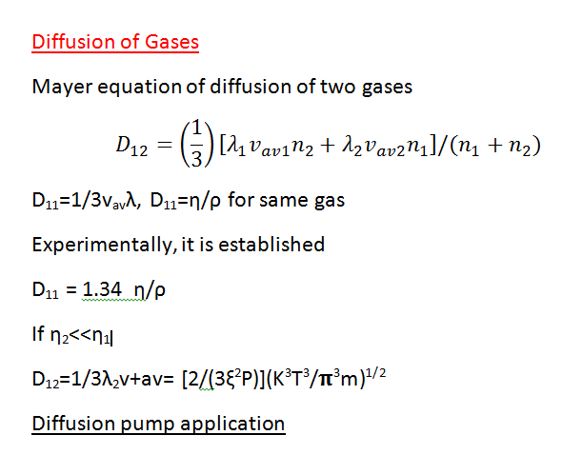
2
1

Slide 3
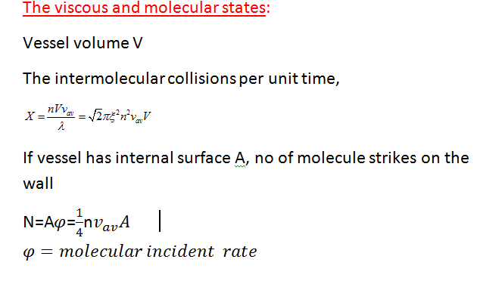

Slide 4
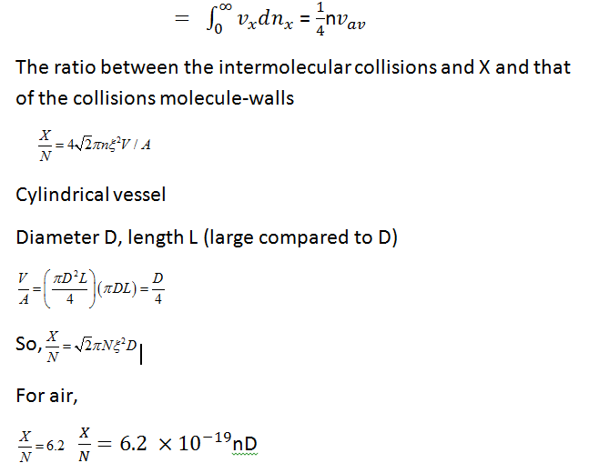
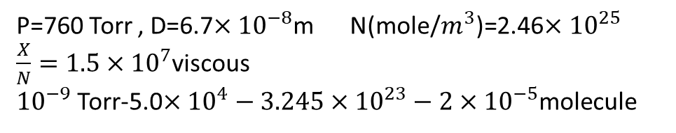
P=760 Torr , D=6.7$×{10}^{−8}$m N(mole/$m^{3}$)=2.46$×{10}^{25}$
$\frac{X}{N}=1.5×{10}^{7}$viscous
${10}^{−9}$ Torr-5.0$×{10}^{4}−3.245×{10}^{23}−2×{10}^{−5}$molecule

Slide 5
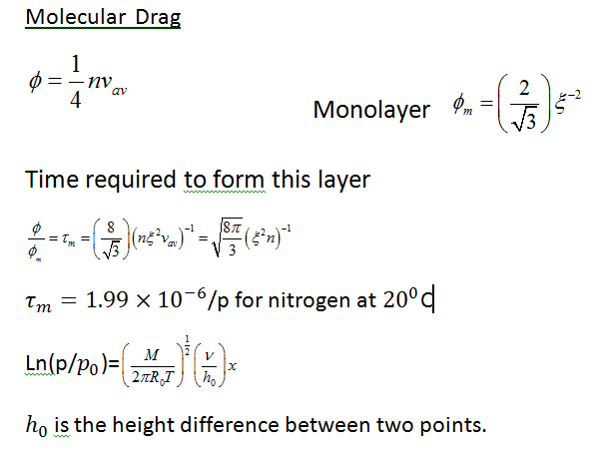
df = (dP/dx)dxh₀y
dq=(1/4)n v_{av}^{mvydx =} (dP/dx)dxh₀y

Slide 6
PREVIOUS CLASSES
1- Error analysis
2- Precession, Resolution etc.
3- Examples of different applications of Vacuum Techniques
4- Units of Pressure and its conversions
5- Basics of Gas Properties
6- Gas laws
7- Velocity of gasses etc.
8- Molecular incident rate, Mean free path
9- Viscosity
Diffusion of Gas
Thermal diffusion: Distinction of gas flow and connections

Slide 7
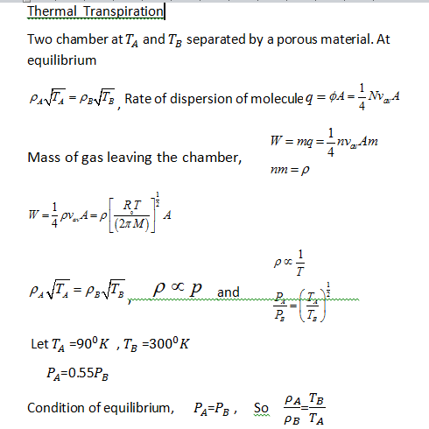

Slide 8
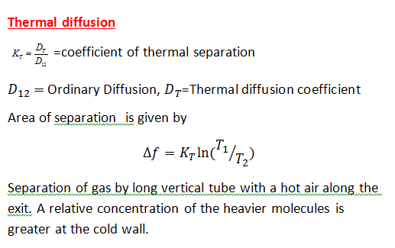
Amount

Slide 9
GAS FLOW AT LOW PRESSURES
Vacuum system
1. Viscous state
2. Molecular state
3. Intermediate state
Viscous state can be:
1 Turbulant -> Re>2100, Q>200D (air)
2. Laminar -> Re<1100, Q<200D(air)
D/λ> 110
Transition : Intermediate 1<D/λ<110
molecular D/λ<1

Slide 10
Limit is defined by the value of the Reynold’s number
Limit(laminar intermediate and molecular flow) is defined by Knudsen number.
Reynold number
R_{e} =
(Dimensionless)
ρ =density of the gas
v=velocity of the gas
η= viscosity of the gas
D=diameter of the tube

Slide 11
The Knudsen number is the ratio D/λ between the diameter of the pipe and the mean free path
D/λ>110 Viscous flow
1<D/λ<110 intermediate flow
D/λ<1 Molecular flow
Through put Q => quality of the gas flowing through a pipe per unit time

Slide 12
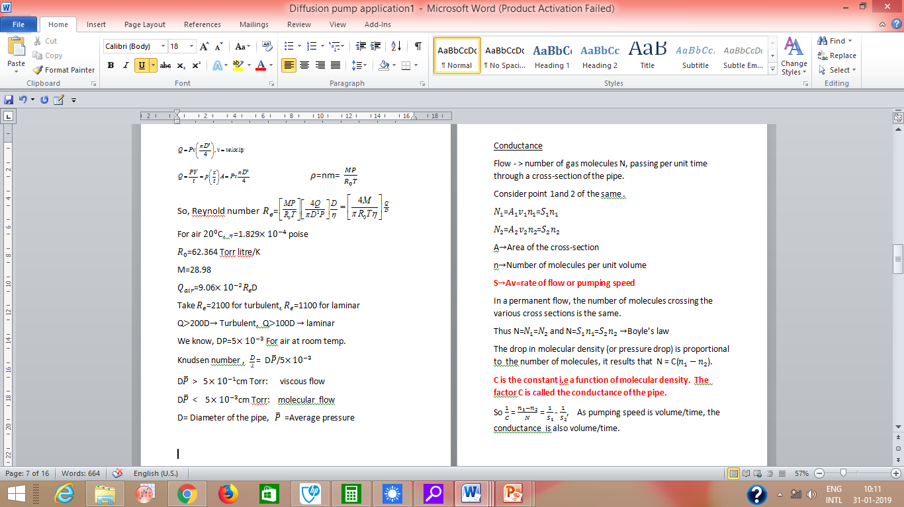

Slide 14
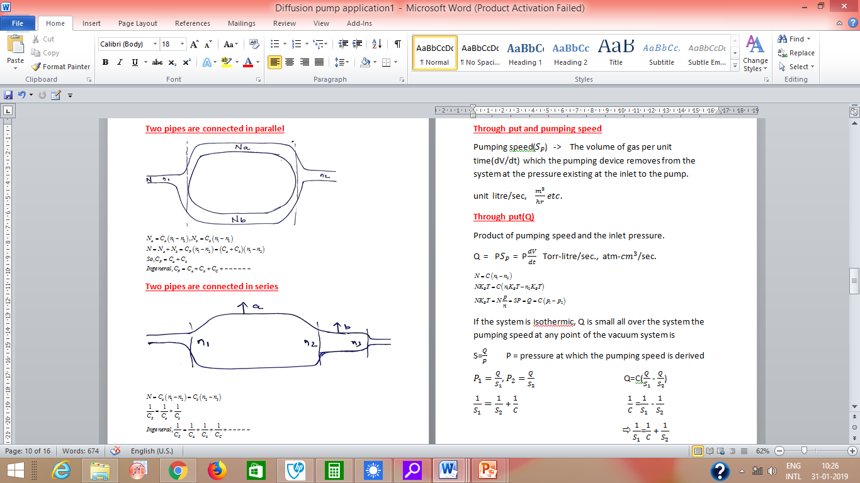

Slide 16
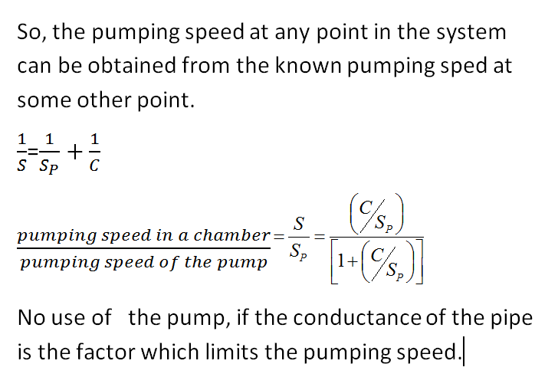

Slide 17
PREVIOUS CLASSES
1- Error analysis
2- Precession, Resolution etc.
3- Examples of different applications of Vacuum Techniques
4- Units of Pressure and its conversions
5- Basics of Gas Properties
6- Gas laws
7- Velocity of gasses etc.
8- Molecular incident rate, Mean free path
9- Viscosity and diffusion of gases
10- Thermal diffusion: Distinction of gas flow and connections
1- Question: Modify the design of McLeod gauge for the better resolution of pressure measurement
2- Write a programme (Software development) to calculate the conductance for different connection design
3- Write a programme to calculate the throughput and pumping speed required for the vacuum chamber
Vacuum PUMPS

